Slide 1
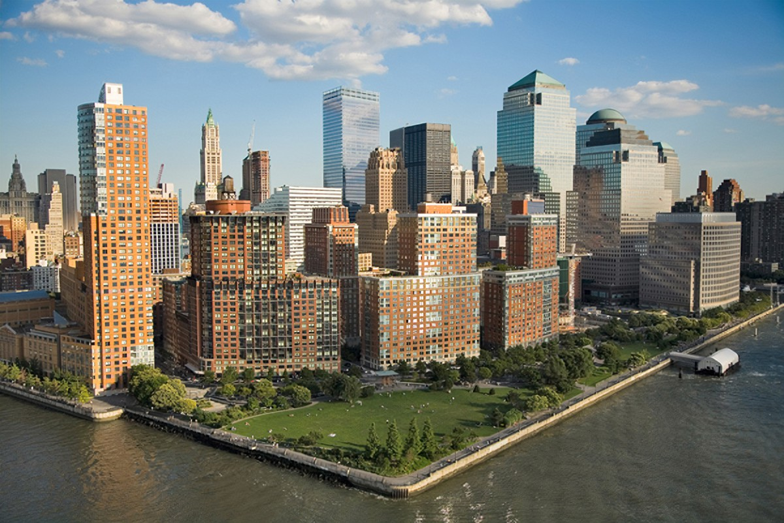


BPCA LMCR Quarterly Update
March 16, 2026

Slide 2
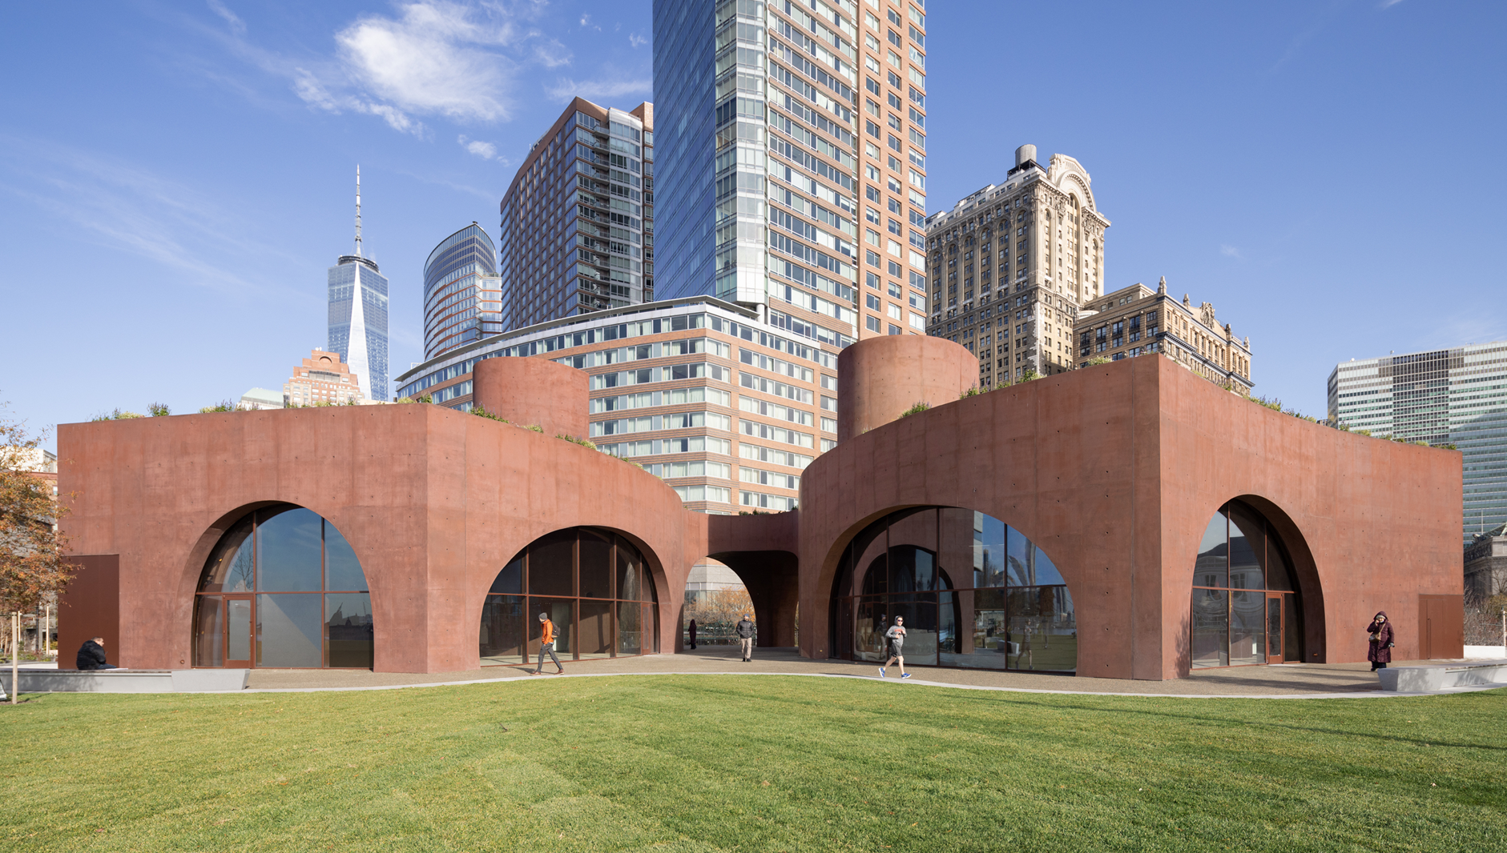
South Battery Park Resiliency Project
Wagner Park/MJH Sitework: 99% Complete
Punch List Work
Administrative Closeout
Wagner Park Pavilion: 95% Complete
Classroom – 3/18 “Open House”
Restaurant Space
Punch List Work
Administrative Closeout
Pier A/The Battery: 70% Complete
Pier A Inlet
Pier A Plaza Tide Gate Installation
Flood Wall Construction
Package 4 Completion (Mid 2026)
Pier A Plaza & The Battery
Wagner Park Lawn Reopening (Spring 2026)
Notes:
Text / Content Slide

Slide 3
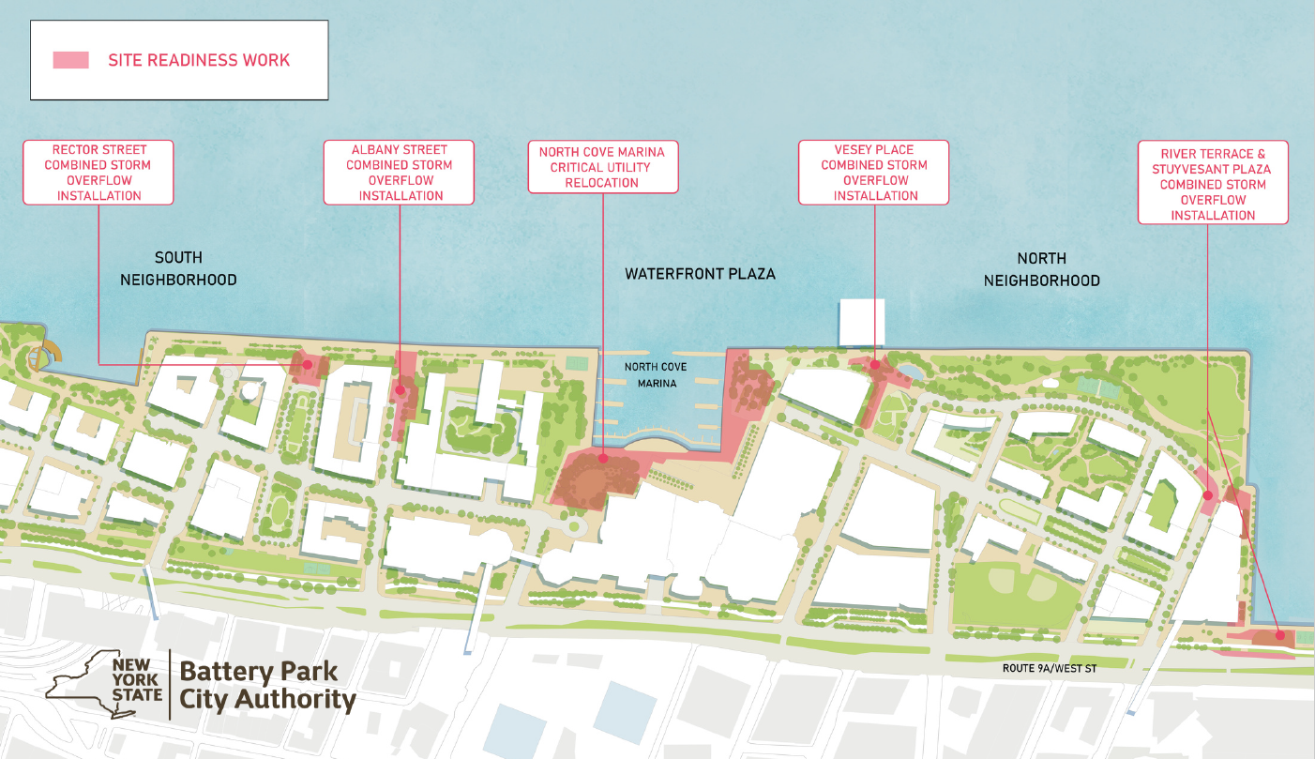
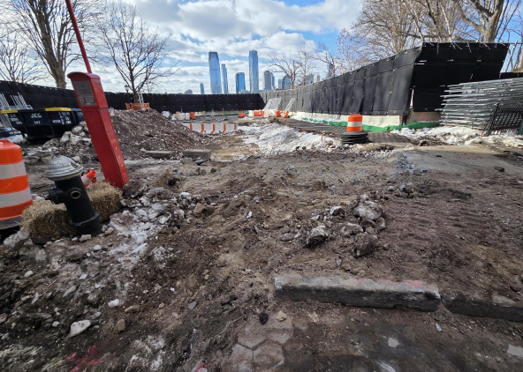
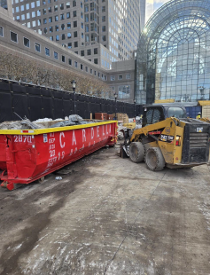
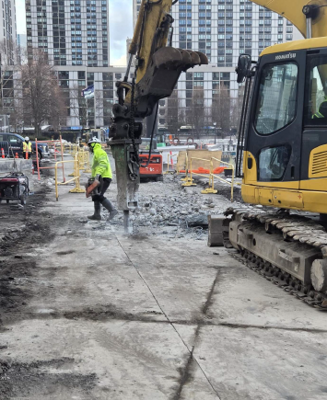
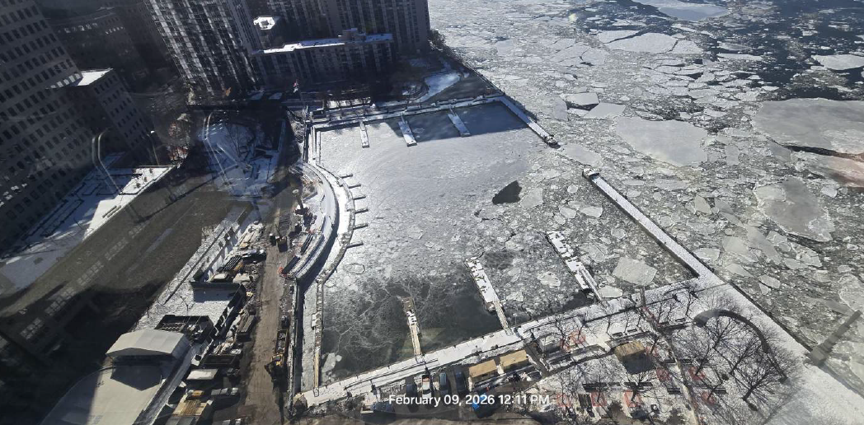
North/West Battery Park City Resiliency: Current & Upcoming Work
North Cove Utility relocation: Ongoing
Route 9A/ Stuyvesant Plaza Utility relocation: Ongoing
Albany Street Tide Gate installation: Ongoing
Chambers Street Tide Gate installation: Ongoing
Route 9A/ Stuyvesant Plaza Tide Gate Installation: Starting this month
Rector Place Tide Gate installation: Starting this month
Vesey Place Tide Gate installation: Starting in June
South Cove Area: Mobilizing soon
Notes:
Text / Content Slide

Slide 4

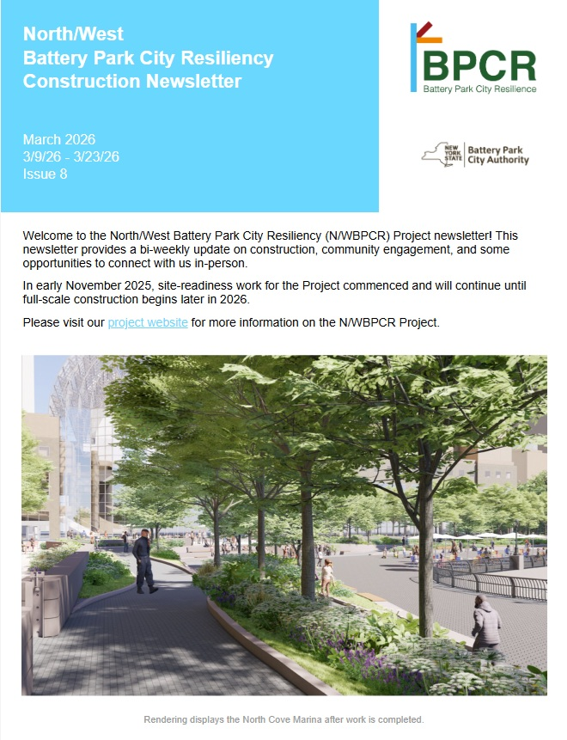
Community Outreach: Upcoming
Spring 2026
On the Ground
Signage and flyers across BPC
BPC Resiliency “Drop-Ins”
Tuesdays thru March 24, 12-1PM at 6 River Terrace
Fridays thru March 27, 10-11AM at 200 Rector Place
New drop spring drop-in hours to be scheduled
Materials at BPCA programming
Stakeholder Engagement
Construction Advisory Committee: March 20 @ 12:30PM
Street Ends Feedback Sessions, 6PM at 200 Rector Community Room:
March 25 (Design Options) & May 20 (Proposed Designs)
Residents
Biweekly Construction Newsletters (sign up here)
Regularly-updated dedicated project website: www.bpcresiliency.info
Community Board 1 Reports & LMCR Quarterly Updates
Flyers in residential buildings & ground floor retail
Community meetings & gatherings (virtual + in-person)
Michael Ryan – Community Construction Liaison (917) 436-6739
nwbpcrinfo.ny.gov
Notes:
Text / Content Slide

